Slide 1

Help session 2
Loops
Polya’s Problem Solving Techniques
Flowcharts

Slide 2
For loops
# Iterate through a list of elements
fruits = ["apple", "banana", "cherry"]
for x in fruits:
print(x)
# Loop through the block a specified number of times.
# In this case starting with 2, ending before 30 and going 3 steps at the time for x in range(2, 30, 3):
print(x)

Slide 3
While loops
# We can now make input validators that could be used on websites
z = 21
while z < 20:
z = int(input("Enter number bigger than 20: "))
print("z is now under 20")
b = "20a"
while not b.isnumeric():
b = input("Enter a number: ")
print("We can now continue with a numeric value")

Slide 4
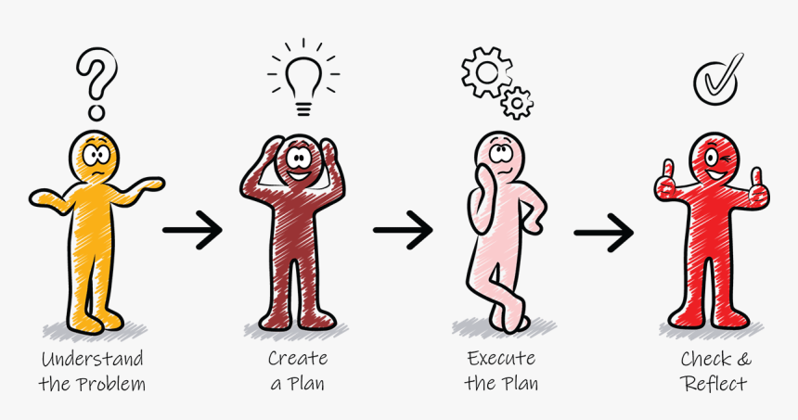
Polya’s Problem Solving

Slide 5
Ocean levels
Assuming the ocean's level is currently rising at about
1.6 millimeters per year, create an application that displays
the number of millimeters that the ocean will have risen each
year for the next 25 years.
Use polya’s problem solving techniques (including a flowchart)

Slide 6
Sum of series
Write a program to calculate the sum of series/sequence up to n term. For example,
if n = 5 the series will become 2 + 22 + 222 + 2222 + 22222 = 24690
Use polya’s problem-solving techniques (including a flowchart/presudocode)

Slide 7
Reversed binary numbers
Bob has a list of binary numbers and he needs help reversing them all. Bob would like to have it printed on the screen.
Ex: binary_numbers = ["10101010", "01011011", "10101000", "01001101", "10101110"]

Slide 8
Shifting Numbers
Bob was satisfied with your last job so he asked you for another favor.
Bob would like to have each number in the list printed out, but with circular shift applied to it.
He would also want to see a flowchart or pseudocode of how it’s achieved in programming since he is also trying to learn it.
An example of a binary number that has undergone a binary circular shift operation would look like this:
10101010 -> 01010101

Slide 9
Thank you!
https://www.pngitem.com/middle/hwwRRxh_polya-4-step-problem-solving-process-team-challenge/ <- image for polya’s problem solving technique

